Slide 1
Dual boot Windows and Linux

Slide 2
Get a Linux disk image
Create bootable media
For this, you will need an empty USB flash drive (any data or files will be deleted).
The easiest way to make your USB drive into a bootable installation media is with the Universal USB Installer. You can download it and find instructions on how to use it on their official website.
Create a partition for Linux
On a desktop computer, you could simply buy and install another hard drive to use for your Linux installation. Otherwise, follow the instructions below to create a new partition.
Right-click the Windows icon on your taskbar, and select ‘Disk Management’.

Slide 3
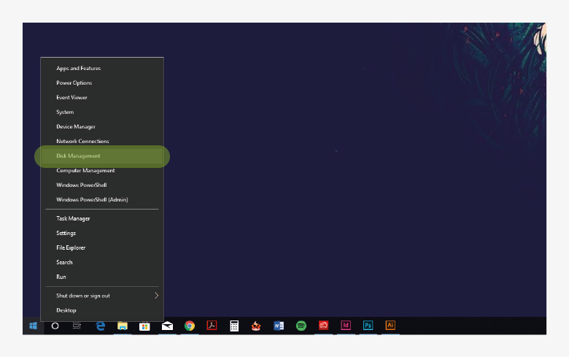

Slide 4
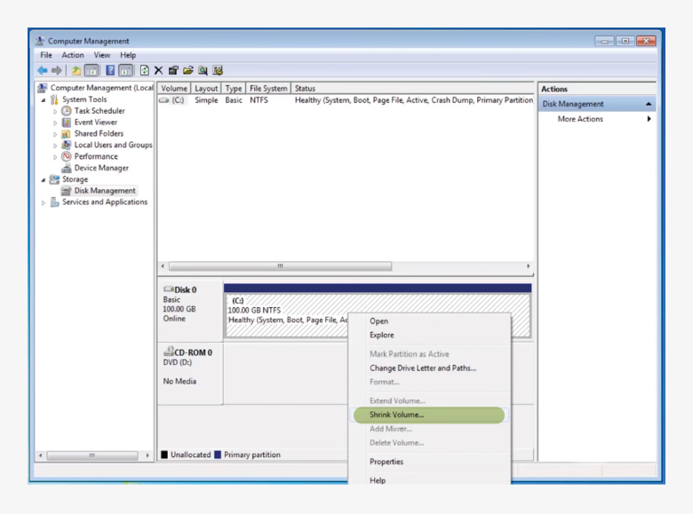
In Disk Management, find the partition that you would like to shrink to make space for your Linux installation. If you only have one disk drive, this will most likely be Windows (C:). Right-click on the partition and select ‘Shrink Volume’.

Slide 5
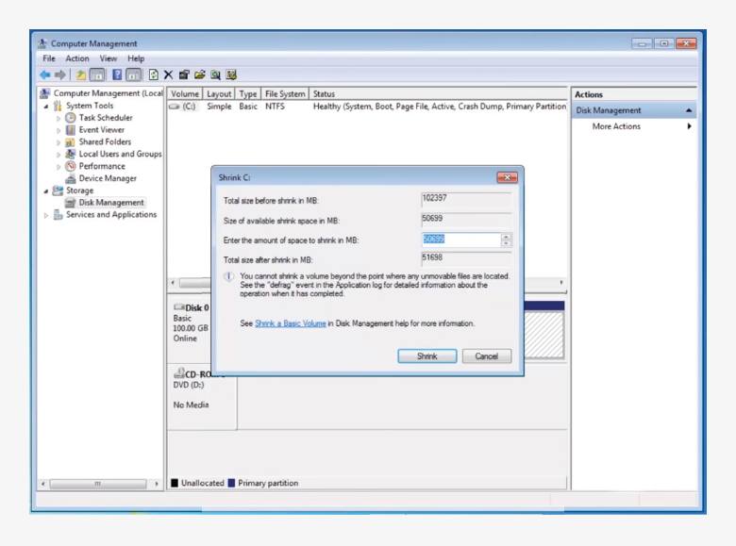
In the dialog box that opens, choose by how much you would like to shrink the partition. For Linux Mint, you will want at least 30GB.

Slide 6
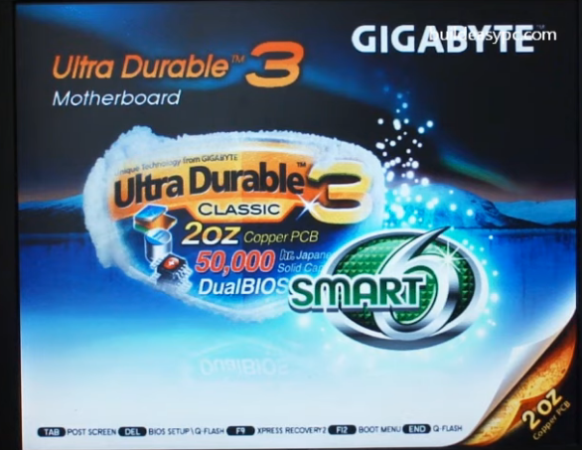

Slide 7
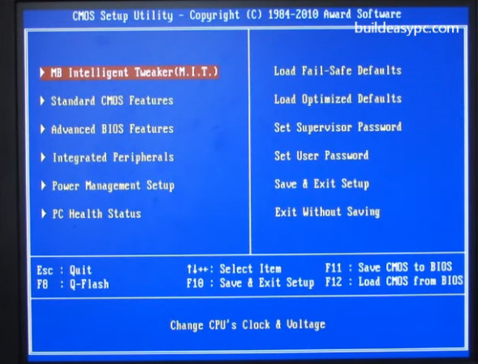

Slide 8
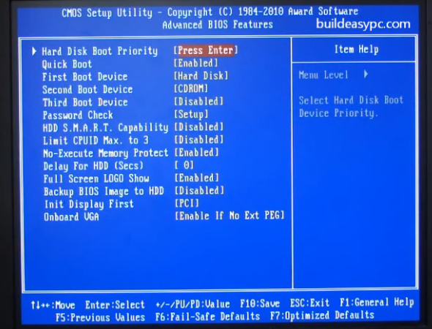

Slide 9
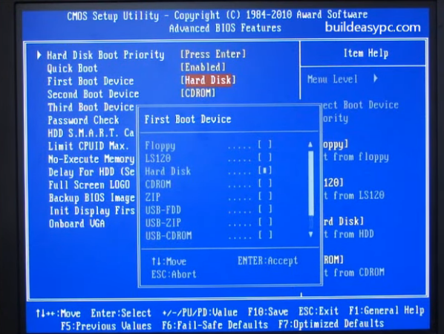

Slide 10
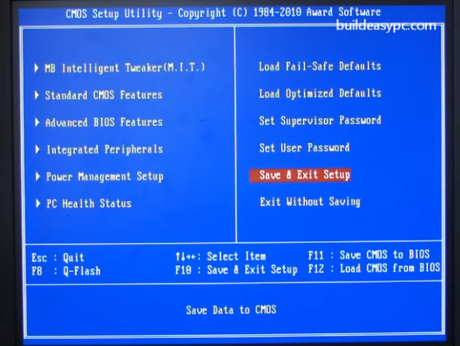

Slide 11
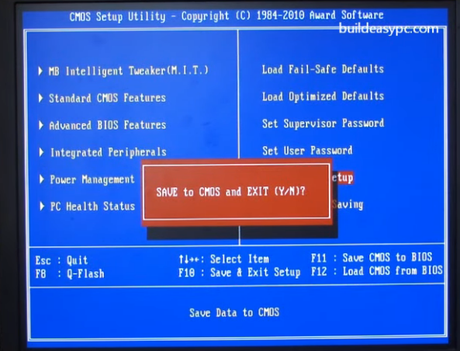

Slide 12
